Slide 1
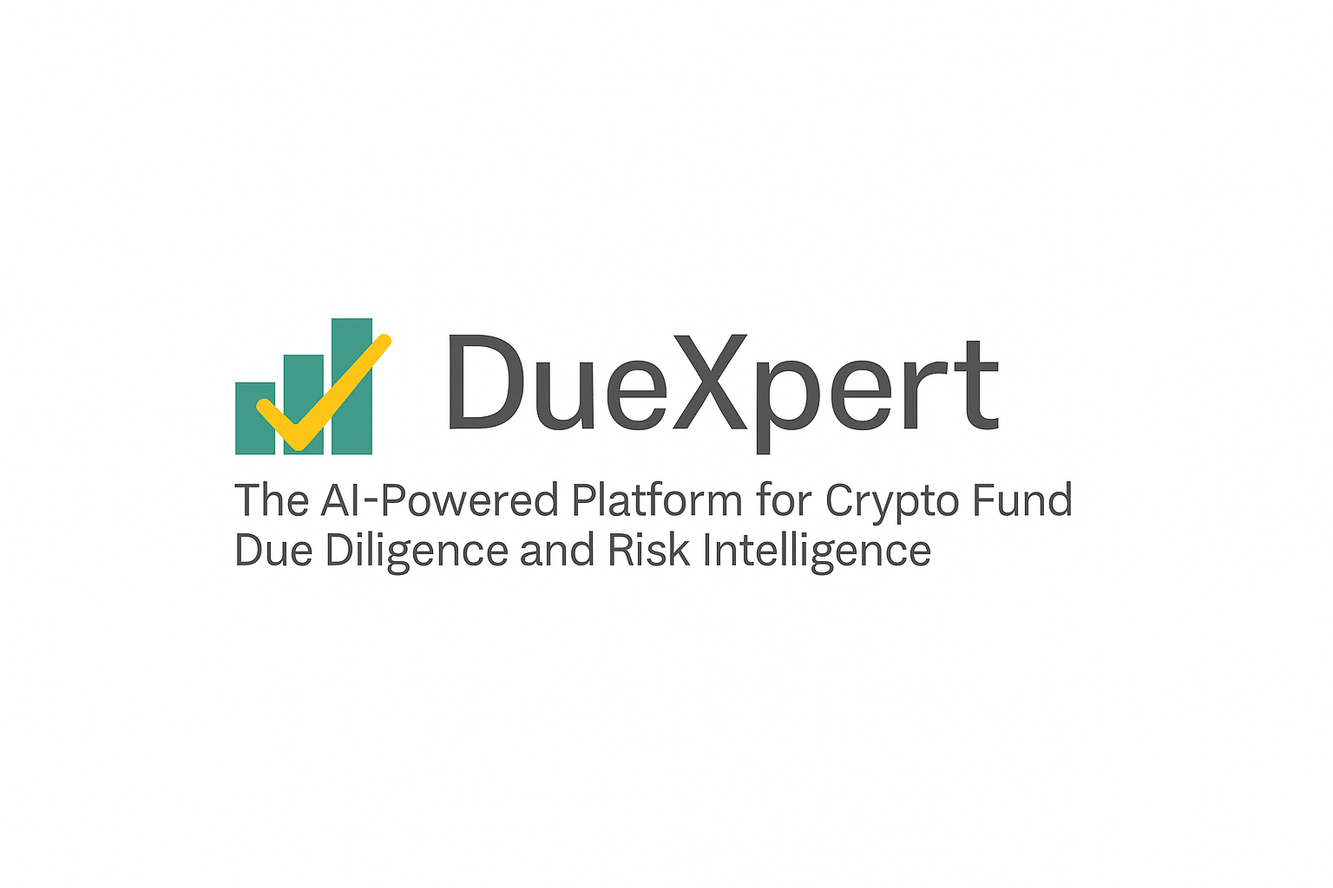
Due Diligence Report
Investee Company
Prepared by DueXpert
2025-04-25
Due Diligence Report | Investee Company | Prepared by DueXpert | 2025-04-25

Slide 2
Contents
1. Management Summary 3
2. Corporate Structure and Ownership 4
3. Financial 5
4. Business Plan 6
5. Sales and Marketing 7
6. Assets 8
7. Management and Staff 9
8. Operations 10
9. Legal 11
10. Risks 12
11. Other Observations 13
12. Recommendations 14
Due Diligence Report | Investee Company | Prepared by DueXpert | 2025-04-25

Slide 3
1. Management Summary
Objective: Summarize key findings of the due diligence exercise.
Key Findings:
• There is no mention of "conflicts" in the provided text.
• Yes, according to the risk warning notice, there is a mention of "actions of state bodies or trading platforms that regulate russian and international securities market" as one of the risks that co-investors assume.
• A thorough review! based on the provided document, here are some potential concerns and questions: 1.
• The provided document, there is no explicit mention of specific risk management strategies for market volatility.
Outstanding Issues:
• - what training programs are in place for employees handling sensitive operations?
Due Diligence Report | Investee Company | Prepared by DueXpert | 2025-04-25
3

Slide 4
2. Corporate Structure and Ownership
Objective: Identify issues with ownership structure that may cause conflicts or prejudice shareholder interests.
Key Findings:
• Based on the provided text, it appears that there is no explicit information about the primary funding sources for the cryptobazar fund.
• The provided text, yes, there are plans for future scalability and growth.
• No, there is no mention of energy-intensive mining methods in the provided text.
• Based on the provided document, it appears that the project is likely a decentralized one.
Outstanding Issues:
• Are there plans for upgrading infrastructure to meet growing demand?
Due Diligence Report | Investee Company | Prepared by DueXpert | 2025-04-25
4

Slide 5
3. Financial
Objective: Ensure a true and accurate picture of the company’s financial state and realistic projections.
Key Findings:
• Based on the provided text, there is no specific mention of "disputes" that could lead to potential financial exposures.
• The answer is not explicitly mentioned in the provided text.
• The document provided does not contain comprehensive financial information about the company's financial health.
• There is no mention of tax disputes or pending issues in the provided text.
Outstanding Issues:
Due Diligence Report | Investee Company | Prepared by DueXpert | 2025-04-25
5

Slide 6
4. Business Plan
Objective: Verify the business plan is realistic, based on reasonable assumptions, and tested ideas.
Key Findings:
Outstanding Issues:
Due Diligence Report | Investee Company | Prepared by DueXpert | 2025-04-25
6

Slide 7
5. Sales and Marketing
Objective: Confirm the company has a plan and skills to market and sell profitably.
Key Findings:
Outstanding Issues:
Due Diligence Report | Investee Company | Prepared by DueXpert | 2025-04-25
7

Slide 8
6. Assets
Objective: Ensure assets have the assumed value and are protected.
Key Findings:
Outstanding Issues:
Due Diligence Report | Investee Company | Prepared by DueXpert | 2025-04-25
8

Slide 9
7. Management and Staff
Objective: Verify the company has the right people and can recruit necessary staff.
Key Findings:
Outstanding Issues:
Due Diligence Report | Investee Company | Prepared by DueXpert | 2025-04-25
9

Slide 10
8. Operations
Objective: Understand if the business is run effectively now and can handle planned growth.
Key Findings:
Outstanding Issues:
Due Diligence Report | Investee Company | Prepared by DueXpert | 2025-04-25
10

Slide 11
9. Legal
Objective: Identify unusual legal obligations that may affect the company’s value.
Key Findings:
• The provided document, the cryptobazar fund is a venture fund that invests in blockchain technology and cryptocurrencies.
• After reviewing the provided text, i did not find any information about significant changes in the legal structure of cryptobazar fund over time.
• There is no explicit mention of whether all necessary licenses and permits are in place.
• The provided text, it appears that there is no explicit mention of sanctions restrictions or transaction monitoring requirements.
Outstanding Issues:
Due Diligence Report | Investee Company | Prepared by DueXpert | 2025-04-25
11

Slide 12
10. Risks
Objective: Identify key risks and mitigation plans.
Key Findings:
Outstanding Issues:
Due Diligence Report | Investee Company | Prepared by DueXpert | 2025-04-25
12

Slide 13
11. Other Observations
Objective: Note additional findings not covered in other sections.
Key Findings:
• Based on the provided documentation, it appears that the cryptobazar fund has not explicitly stated its compliance with relevant securities and commodities laws.
• The provided text does not mention specific anti-money laundering (aml) policies and procedures.
• Based on the provided text, there is no information about the company owning any intellectual property (ip) assets.
• After reviewing the provided text, i did not find any specific information about intellectual property (ip) infringement issues.
Outstanding Issues:
• Are there any initiatives to reduce this footprint?
Due Diligence Report | Investee Company | Prepared by DueXpert | 2025-04-25
13

Slide 14
12. Recommendations
Objective: Provide guidance on further investigations or conditions for proceeding.
Key Findings:
Outstanding Issues:
Due Diligence Report | Investee Company | Prepared by DueXpert | 2025-04-25
14

